Slide 1
Pens and Printers
Sales Strategy

Slide 2
OVERVIEW
This presentation aims to analyze Products Sales across different Sale Method, namely - Email, Calls, and Email + Calls.
Our aim is to evaluate the effectiveness of each sales approach to identify which can contribute to more sales.
The structure leading to the recommendation is as follows -
Data Validation
Exploratory Analysis
Describing Metrics to Monitor.
Recommendation.
By the end of this presentation, you’ll gain insights into which sales approach delivers the best results and how these findings can inform future marketing decisions.

Slide 3

DATA VALIDATION

Slide 4
The dataset provided required validation, as an initial exploration revealed several inconsistencies. Two columns in particular — Sales Method and Years as Customer — required corrective action.
‘Sales_method’:
Expected: 3 valid categories
Found: Extra entries — ‘email’, ‘Em + call’ (formatting errors)
Action: Standardized categories using .str.capitalize() and .str.replace()
Result: Restored to 3 consistent values.
‘years_as_customer’:
Outliers detected: 47 and 63 years
Context: Company established in 1984 → only 41 years old in 2025
Action: Removed invalid entries
After these adjustments, all columns maintained their structural integrity and appropriate data types.

Slide 5

EXPLORATORY ANALYSIS

Slide 6
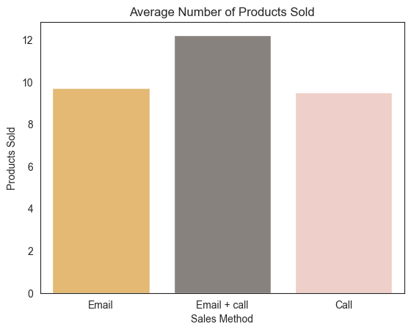
PRODUCTS SOLD
Email + Call method results in highest number of products sold.
Email and Call methods perform almost the same.

Slide 7
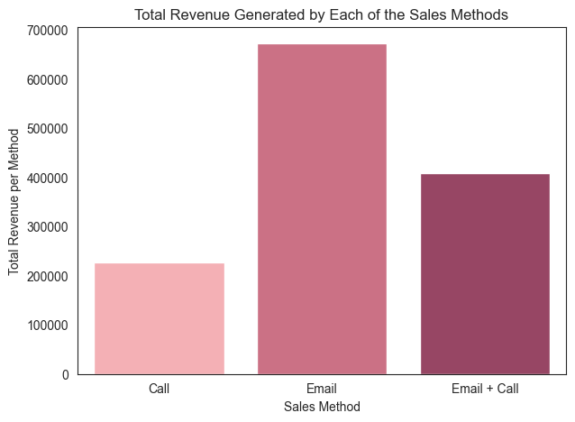
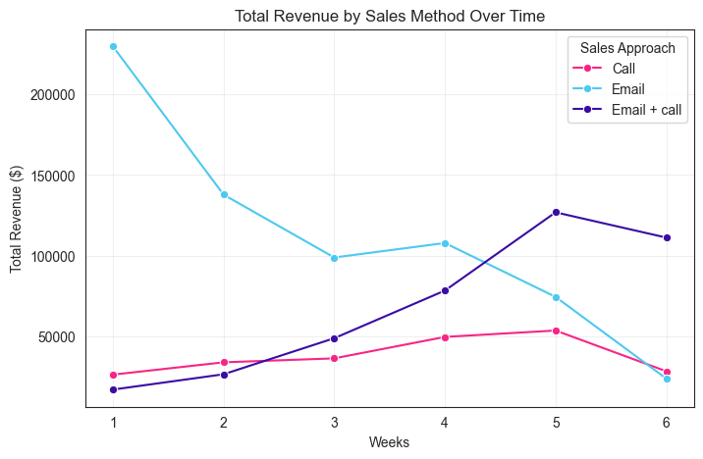
TOTAL REVENUE BY SALES METHOD
Email + Calls display steady rise in revenue over time, where as, Email Method decreases after starting huge.
Email method generates huge revenue compared to others.

Slide 8
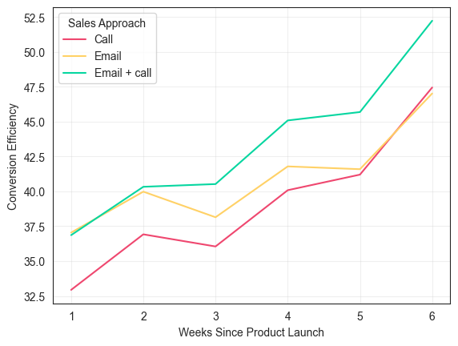
CONVERSION RATE SINCE THE LAUNCH
Conversion rate = products sold per number of site visits.
Measure of efficiency observed to be the highest in ‘Email + Calls’ method.

Slide 9
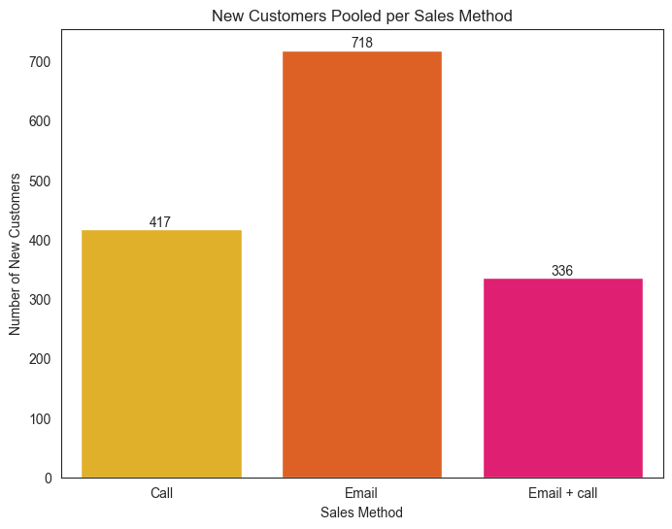
NEW CUSTOMERS POOLED
Email method attracts highest number of new customers.
Calls help attract modest amount of new customers, but requires a lot of time.
The Email + Call method is the least effective, but it’s more long-term oriented.

Slide 10

METRICS TO MONITOR
Conversion Efficiency.
New Customers Per Method.
Revenue Over Time.

Slide 11
RECOMMENDATIONS
Since the business goal is to maximize sales, Email + Call Method seems to be well suited and balanced.
Monitoring Metrics with huge data accumulated over time, should give us more precise insights.
Metrics like Conversion Efficiency, Revenue Over Time, etc., can assess these methods in the long run.

Slide 12


